Slide 1
창의성 설계
좋조
2014270232조성현
2014270220 조수연

Slide 2
Table of Contents
내일로 모레로
What is 내일로?
Introduction
Related Research
Scope of Implementation
Problem Definition and Suggestion
Difference with Existing Apps
Schedule

Slide 3
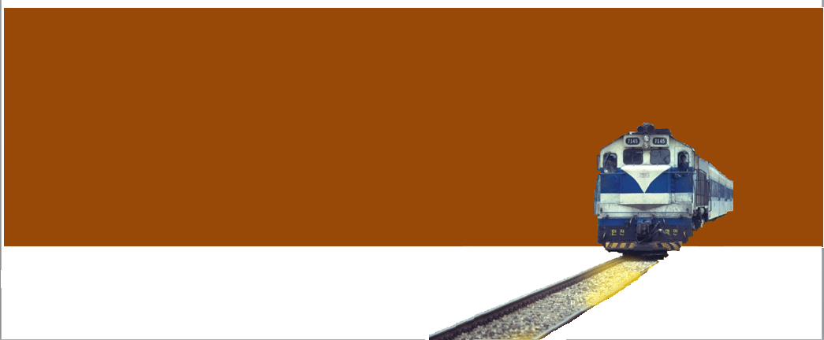
내일로 모레로
What is 내일로?
내일로(Rail路) is a season ticket of Korail which has begun since 2007 summer. Also, winter season ticket has begun since 2010. Under 25 year-old-Koreans can take the train.

Slide 4
Motive
Introduction
Inconvenience based on experience of using existing Railro applications.
Introduction
내일로 모레로
To provide useful information while taking a trip by Railro in just one application, such as accommodations, attractions, restaurants.
Productivity
Despite of age cut-off, Increasing accessibility to the young people by making an application.

Slide 5
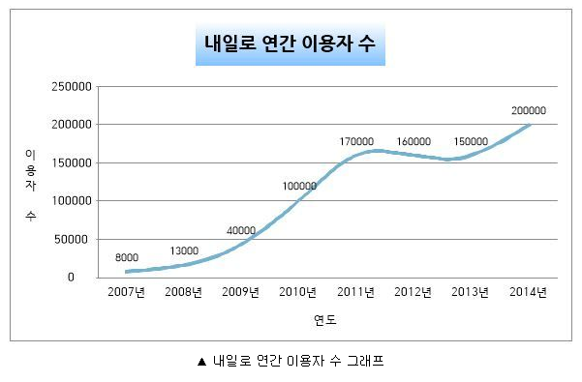
Profitability
내일로 모레로
Steadily Increasing since 2007
Major User – College Students – Every Year New College Students
Adding ads in one side of the app, we can drag profitability out.
내일로 연간이용자 수

Slide 6
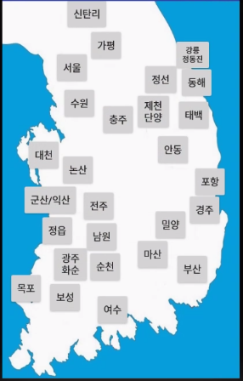
System Flow
내일로 모레로
webview
restaurant
Adding schedule
attraction
webview
accommodation
webview
Map

Slide 7
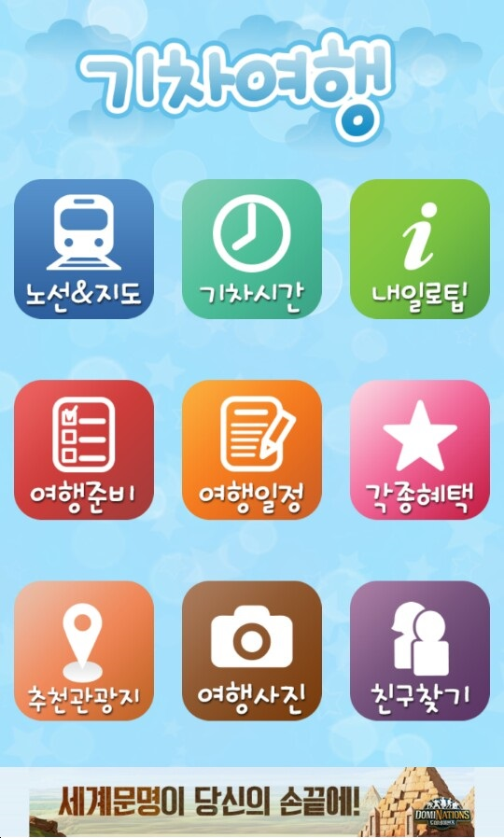

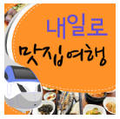

Difference with Existing Apps
Train Time – Modifying
Recommendation of Attractions - Modifying
Restaurants Travel – Only Provides Restaurants
Recommendation of Accommodations – Only Provides Accommodations
Theme(경춘선) – Only Provides Information of Stations in 경춘선

Slide 8
☆AFTER FEEDBACK
More detail

Slide 9



Difference with Other Apps
2014
Train Routes&Maps
Only Provides
Train Routes and Maps
Tips for Railro
Provides Tips for Railro

Slide 10





Preparing & Schedule
Provides Memo
Various Benefits
General Manager – PT Brocco
Provides Benefits given to Railro Users
Looking for Friends & Photos
Users can write Postscripts for Communication

Slide 11
Scope of Implementation
내일로 모레로
Basically Provides Information of
Major Stations
Provides Various Restaurants, Attractions, Accommodations
Scheduler

Slide 12
Problem Definition and Suggestions
내일로 모레로
Problem Definition
Existing apps do not provide information which we will provide in one app, so Railro users had to use various kinds of apps. Therefore, users need to install many apps. As a result, due to opening background apps, considerable battery usage is critical weakness.
Suggesting Ideas
This project combines restaurants, attractions, and accommodations in one app and makes users can look for information and can add those information to their scheduler so that they can assure what their schedule was.
Day 1
Day 2
Day 3
Day 4
Day 5
전주
Restaurant 000
Attraction 000
Accommodation 000
대구
Restaurant 000
Attraction 000
Accommodation 000
부산
Restaurant 000
Attraction 000
Accommodation 000
여수
Restaurant 000
Attraction 000
Accommodation 000
익산
Restaurant 000
Attraction 000
Accommodation 000

Slide 13
Schedule
내일로 모레로
OCT
NOV
Idea Concept
UI Design
Development Environment
Interim Presentation
App materialization
Supplementary Revision
Get this Plan
Get this Plan

Slide 14
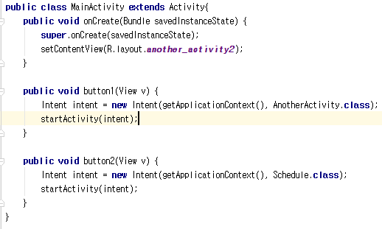
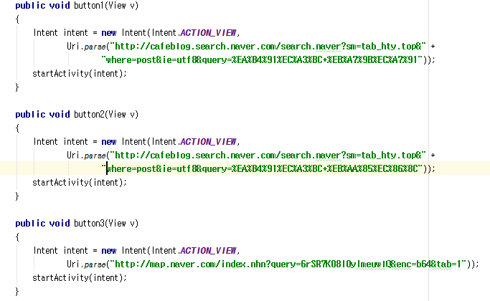
Codings
▼Parsing restaurant, attraction and accommodation
▲Main page

Slide 15
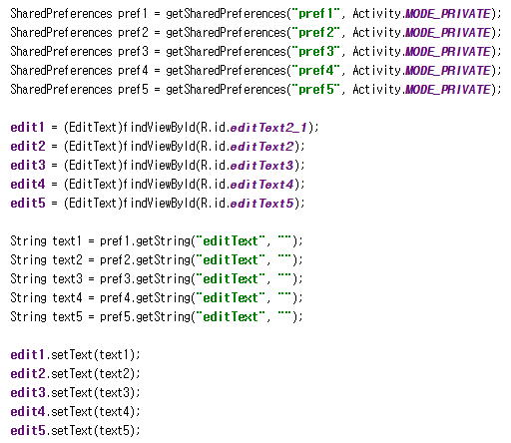
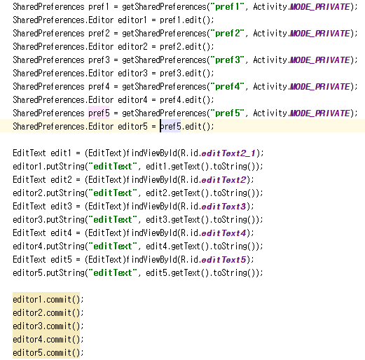
▲By using 'Shared Preference',
the added links will remain despite of turning off the app

Slide 16
Thank you♡

